Slide 1
6CS005 High Performance Computing
Week 1 Multithreading Revision

Slide 2
What is Multitasking?
Multitasking is running multiple programs at the same time a single operating system.
On a single-core CPU computer, only one task/program is running at any one time on the CPU.
At predetermined intervals, the operating system pauses the current task, saves its state and loads another task into the CPU an runs it.
This is called context-switching.

Slide 3
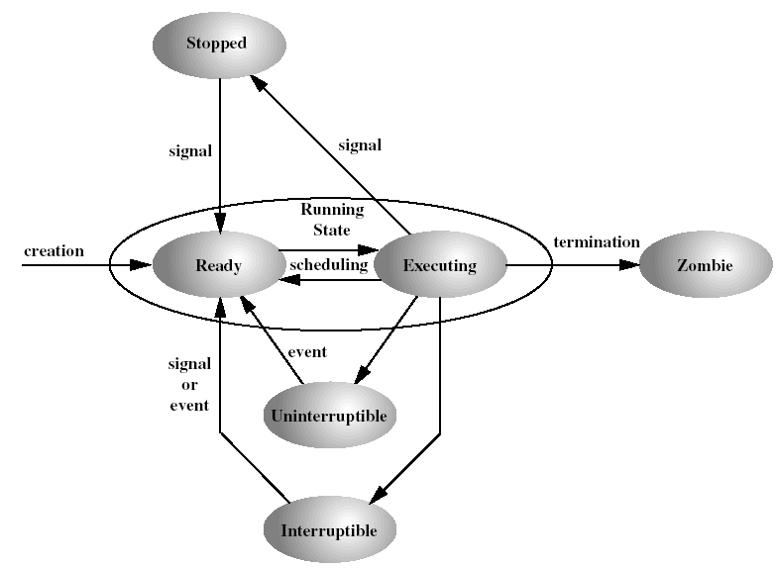
Process States
Notes:
Running – either executing or ready to execute (made out of two states)
Interruptible – this is a blocked state, in which the process is waiting for an event, such as the end of an I/O operation, the availability of a resource or a signal from another process
Uninterruptible – this is another blocked state. The difference between this and the previous is that here a process is waiting directly on hardware conditions and therefore will not accept any signals.
Stopped – the process has been halted and can be resumed only by positive action from another process (i.e. a process that is being debugged can be stopped by another process- the debugger).
Zombie – process has been terminated but still must have its task structure in the task list (process table).

Slide 4
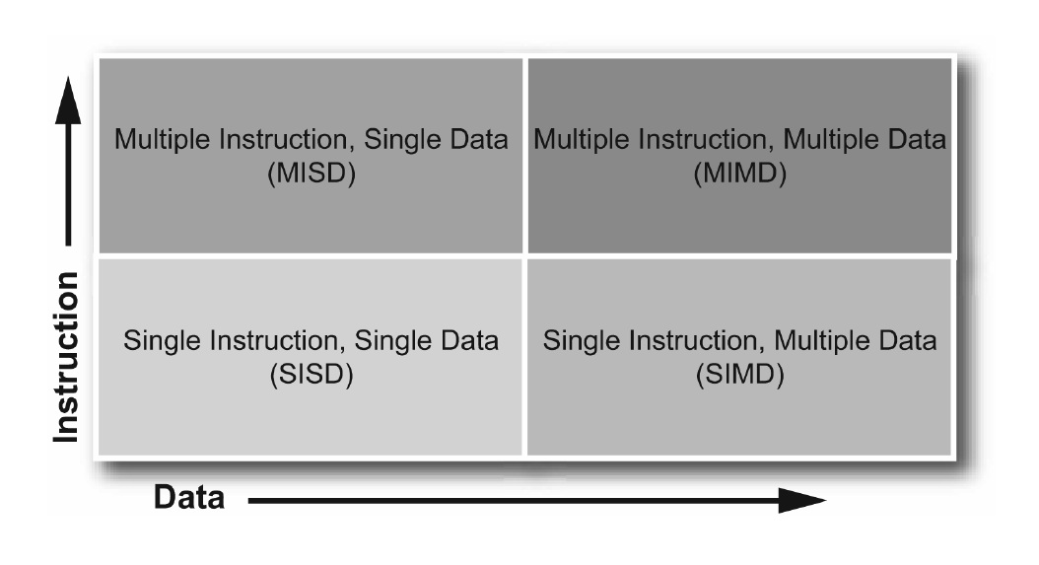
Flynn’s Taxonomy on Parallelism

Slide 5
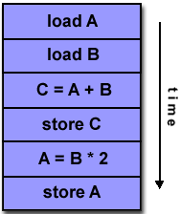
Single Instruction, Single Data (SISD)
Provides no parallelism in hardware
1 data stream processed by the CPU in
1 clock cycle
Instructions executed in serial fashion

Slide 6
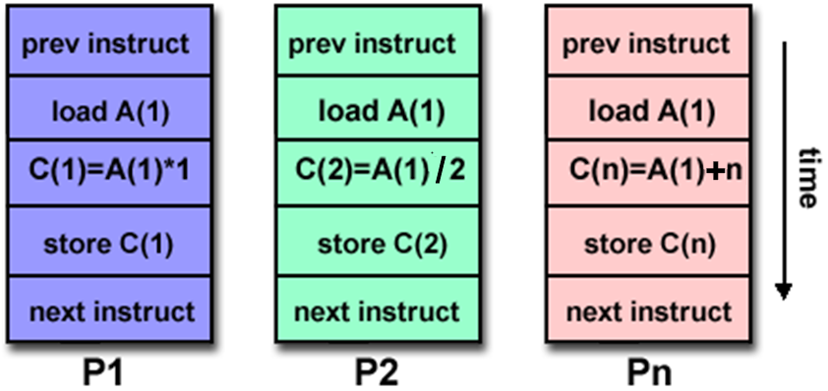
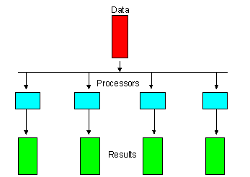
Multiple Instruction, Single Data (MISD)
Process single data stream using multiple instruction streams simultaneously

Slide 7
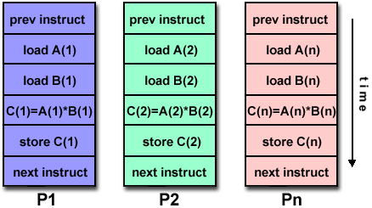
Single Instruction, Multiple Data (SIMD)
Single instruction steam has ability to process multiple data streams in 1 clock cycle
Takes operation specified in one instruction and applies it to more than 1 set of data elements at 1 time
Suitable for graphics and image processing

Slide 8
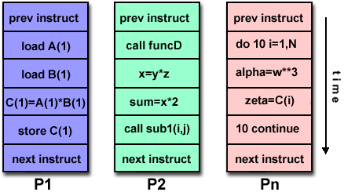
Multiple Instruction, Multiple Data (MIMD)
Different processors can execute different instructions on different pieces of data
Each processor can run independent task

Slide 9
Concurrency and Parallelism
3 Main types of concurrent or parallel programming systems
  Concurrent Processing or Multitasking
  Multithreading
  Distributed Computing

Slide 10
What is Multithreading?
Multithreading is the parallel execution of multiple instances of your program's code, within the same process.
Multithreading is similar to multitasking except that all the running programs(threads) share same the same memory, the same variables and everything else in the program.
The individual threads can have either little or high interactions with each other.

Slide 11
Multitasking
Multitasking is the concurrent execution of multiple, related, processes, collaborating to achieve an objective.
The individual processes generally have minimal interactions with each other.
Each process is control by the operating system individually and independently.
Data is often shared through files, and network work messages.
Traditionally, all Unix processes worked this way before multithreading was available.

Slide 12
Distributed Computing
Very similar to multitasking, except that the processes can potentially be running on separate computers on a network.
Relies on network messages to interact and exchange data between processes.
Generally requires a standardised system or framework to operate: e.g. Actor, Message Passing Interface.

Slide 13
Multithreading
Modern processor have more than one CPU core: up to 24 cores on the Intel i9-13900K
The Nvidia RTX 3080 has 8704 CUDA cores.
Single-threaded programs can only use 1 core at a time.
Multi-threaded programs can spread the processing load across all the cores available.
For example an image processing program can divide up an image into 16 equal parts and process each parts using a separate thread, and this will run up to 16 times faster than a single-thread program

Slide 14
Why not Multithreading Everywhere?
It is not always possible to break a problem down into separate equal parts, for example, processing a file that is received over the network, one character at a time.
It is sometimes difficult to organise and manage the work divided between threads efficiently:
  Imagine a fast food kitchen with multiple cooks looking at the same items from a large order screen. Who cooks what when?
When the timing of a process is critical, eg. aeroplane flight controller software, multithreading can introduce uncertainties.

Slide 15
How to use threading in C?
The POSIX Threads standard published in 1995, is the most widely used threading API, also known as "pthreads".
To use pthreads, you have include the header file <pthread.h>
To create and start a thread, you have to call the API pthread_create()
To wait for a thread to finish, you have to call the API pthread_join()

Slide 16
Pthreads Example
#include <pthread.h>
#include <stdio.h>
void *threadOne(void *p){
for(int i=0; i<1000; i++)
printf("Thread One: i=%d\n",i);
}
void *threadTwo(void *p){
for(int i=0; i<1000; i++)
printf("Thread Two: i=%d\n",i);
}
void main(){
pthread_t thrID1, thrID2;
pthread_create(&thrID1, NULL, threadOne, NULL);
pthread_create(&thrID2, NULL, threadTwo, NULL);
pthread_join(thrID1, NULL);
pthread_join(thrID2, NULL);
}

Slide 17
Converting Single Thread to Multithreaded
#include <stdio.h>
void main()
{
int i, c;
int nstart=1, nfinish=20000;
printf("Prime numbers between %d and %d are :\n", nstart, nfinish);
for(i=nstart; i<=nfinish; i++){
for(c = 2; c <= i-1; c++){
if ( i%c == 0 )
break;
}
if ( c == i )
printf("%d\n", i);
}
}

Slide 18
Multithreaded Version - 2 threads
#include <stdio.h>
#include <pthread.h>
void *threadOne(void *p){
int i, c;
int nstart=1, nfinish=10000;
for(i=nstart; i<=nfinish; i++){
for(c=2; c <= i-1; c++){
if ( i%c == 0 )
break;
}
if ( c == i )
printf("threadOne : %d\n", i);
}
return 0;
}
void main(){
pthread_t thrID1, thrID2;
printf("threadOne : Prime numbers between %d and %d are :\n", nstart, nfinish);
pthread_create(&thrID1, NULL, threadOne, NULL);
pthread_create(&thrID2, NULL, threadTwo, NULL);
pthread_join(thrID1, NULL);
pthread_join(thrID2, NULL);
}
void *threadTwo(void *p){
int i, c;
int nstart=10001, nfinish=20000;
for(i=nstart; i<=nfinish; i++){
for(c=2; c<=i-1; c++){
if ( i%c==0 )
break;
}
if ( c==i )
printf("threadTwo : %d\n", i);
}
return 0;
}

Slide 19
Any-Threaded Version
void main(int argc, char **argv){
int numThreads = 0;
int i;
pthread_t thrID[100];
struct threadArgs targs[100];
if ( argc > 1 ) {
numThreads = atoi(argv[1]);
}
if (numThreads > 0 && numThreads <= 100){
int chunksize = 10000/numThreads ;
for (i=0; i < numThreads; i++){
targs[i].start = i * chunksize;
targs[i].finish = (i * chunksize) + chunksize;
pthread_create(&thrID[i], NULL, threadMain, &targs[i]);
}
for (i=0; i < numThreads; i++){
pthread_join(thrID[i], NULL);
}
}
}
#include <stdio.h>
#include <pthread.h>
#include <stdlib.h>
struct threadArgs {
int start;
int finish;
};
void *threadMain(void *p){
struct threadArgs *pargs = p;
int i, c;
int nstart=pargs->start, nfinish=pargs->finish;
pthread_t tid = pthread_self();
for(i=nstart; i<=nfinish; i++){
for(c=2; c<=i-1; c++) {
if ( i%c==0 )
break;
}
if ( c==i )
printf("Thread %ld : %d\n",tid, i);
}
return 0;
}

Slide 20
pthread_create()
int pthread_create(
pthread_t *threadID,
pthread_attr_t *attr,
void *(*thread_function) (void *),
void *targ);
Creates a thread and executes thread_function
threadID - pointer to a thread ID variable to identify the thread after it has been created.
attr - thread attributes (OS dependent) - normally NULL;
thread_function - the main thread function.
targ - pointer to the parameter. Can be NULL;
On success, pthread_create() returns 0; on error, it returns an error number

Slide 21
pthread_join()
int pthread_join(pthread_t threadID,
void **retval);
Waits for the thread with threadID to finish.
threadID - the id of the thread specified by pthread_create()
retval - a thread can return a value via the function pthread_exit(). retval is a pointer to the return value.
On success, pthread_join() returns 0; on error, it returns an error number.

Slide 22
Ending and returning results from a thread
void pthread_exit(void *retval)
  This function terminates the calling thread and returns a value via the location pointed to by retval.
  retval must point to a valid memory location when the calling thread terminates.
  retval must not point to a local thread variable.

Slide 23
pthread_exit()
#include <pthread.h>
#include <stdio.h>
char retval[] = "Hello there!";
void *threadOne(void *p){
pthread_exit(retval);
}
void main(){
void *pretval1;
pthread_t thrID1;
pthread_create(&thrID1, NULL, threadOne, NULL);
pthread_join(thrID1, &pretval1);
printf("*pretval1 = %s\n", (char *)pretval1);
}

Slide 24
Returning an int value
int gretval=0;
void *threadOne(void *p){
gretval = 42;
pthread_exit(&gretval);
}
void main(){
void *pretval1;
int retval;
pthread_t thrID1;
pthread_create(&thrID1, NULL, threadOne, NULL);
pthread_join(thrID1, &pretval1);
retval=*(int *)pretval1;
printf("*pretval1 = %d\n", retval);
}

Slide 25
Return dynamic memory
void *threadOne(void *p){
char *retval;
retval= malloc(1000);
strcpy(retval, "Hello world!");
pthread_exit(retval);
}
void main(){
void *pretval;
pthread_t thrID1;
pthread_create(&thrID1, NULL, threadOne, NULL);
pthread_join(thrID1, &pretval);
printf("*pretval = %s\n", (char *)pretval);
free(pretval);
}

Slide 26
Return dynamic memory
void *threadOne(void *p){
int *retval;
retval= malloc(sizeof(int));
*retval = 42;
pthread_exit(retval);
}
void main(){
void *pretval;
int retval;
pthread_t thrID1;
pthread_create(&thrID1, NULL, threadOne, NULL);
pthread_join(thrID1, &pretval);
retval=*(int *)pretval;
printf("retval = %d\n", retval);
}

Slide 27
Cancelling a running thread
int pthread_cancel(pthread_t thread)
  This function sends a cancellation request to the specified thread.
  The thread can be canceled at any time, usually immediately, but this is not guaranteed

Slide 28
Cancelling a running thread
#include <pthread.h>
#include <stdio.h>
#include <unistd.h>
void *threadFunc(void *p){
long i;
for(i = 0; i <10000000; i++){
printf("i = %ld\n", i);
}
}
void main(){
pthread_t thrID;
pthread_create(&thrID, NULL, threadFunc, NULL);
sleep(1);
pthread_cancel(thrID);
pthread_join(thrID, NULL);
}

Slide 29
Cancelling a run-away thread
#include <pthread.h>
int counter = 0;
void *threadFunc(void *p){
long i;
for(i = 0; i <1000000; i++){
printf("i = %ld\n", i);
counter = i;
}
}
void main(){
pthread_t thrID;
pthread_create(&thrID, NULL, threadFunc, NULL);
sleep(1);
if (counter < 100000){
pthread_cancel(thrID);
printf("Thread cancelled\n");
}
pthread_join(thrID, NULL);
}

Slide 30

Critical Sections
When multiple threads share global resources, they may interfere with each other
We need a protection mechanism to prevent this interference
Critical section - section of code that need this protection

Slide 31
Thread interference
int counter=0;
void *threadOne(void *p)
{
for(int i=0; i<1000; i++){
counter =
doSomething(counter);
}
}
void *threadTwo(void *p)
{
for(int i=0; i<1000; i++){
counter =
doSomething(counter);
}
}
void main()
{
pthread_t thrID1, thrID2;
pthread_create(&thrID1, NULL,
threadOne, NULL);
pthread_create(&thrID2, NULL,
threadTwo, NULL);
pthread_join(thrID1, NULL);
pthread_join(thrID2, NULL);
printf("Final counter = %d\n",
counter);
}

Slide 32
Critical Section
The critical section that needs to be protected in this code is this bit in both threads:
for(int i=0; i<1000; i++){
counter = doSomething(counter);
}

Slide 33
Protecting Critical Sections
The critical section is protected by mutex:
for(int i=0; i<100; i++){
pthread_mutex_lock(&mutex);
counter = doSomething(counter);
pthread_mutex_unlock(&mutex);
}

Slide 34
Pthread Mutex Functions
pthread_mutex_init (mutex,attr)
  Initialises the mutex, "attr" is optional, and implementation dependent; should be set to NULL
pthread_mutex_destroy (mutex)
  Frees the resources used by the mutex
pthread_mutex_lock (mutex)
  Locks the mutex. If the mutex is already locked by another thread, it will wait, until it acquires the lock
pthread_mutex_unlock (mutex)
  Unlocks the mutex. If another thread is waiting to lock the mutex, the lock will be transfered to the waiting thread.
pthread_mutex_t
  This is the mutex datatype.

Slide 35
Deadlocks
With mutex, there is the possibility of deadlocks.
This is when all the threads are waiting for different mutexes which are locked by other threads. E.g.:
  Thread A locks Mutex 1
  Thread B locks Mutex 2
  Thread A attempts to lock Mutex 2
  Thread B attempts to lock Mutex 1
  Deadlock!

Slide 36
Avoiding deadlocks
pthread_mutex_trylock (mutex)
  pthread_mutex_trylock() will attempt to lock a mutex.
  However, if the mutex is already locked, the routine will return immediately with a non-zero error code.
  This may be useful in preventing deadlock conditions

Slide 37
Semaphores
Mutexes allow only one thread to enter a critical section at a time.
This can have a significant performance impact when there are lots of threads
Semaphores are an alternative method of synchronizing multiple threads
This can allow multiple threads to access a "pool" of resources at the same time without interfering with each other.

Slide 38
Semaphore functions
int sem_init (sem_t *sem, int pshared, unsigned int value)
  sem_init initializes the semaphore. The pshared indicates whether the semaphore is local to the current process (0) or is to be shared between several processes (not zero)., The value is the initial count value of the semaphore.
int sem_destroy (sem_t * sem)
  sem_destroy frees the resources held by the semaphore..
int sem_wait (sem_t * sem)
  sem_wait suspends the calling thread until the semaphore pointed to by sem has non-zero count. It then decreases the semaphore count.
int sem_post (sem_t * sem)
  sem_post increases the count of the semaphore pointed to by sem. This function never blocks.

Slide 39
Simple Semaphore example
#include <stdio.h>
#include <pthread.h>
#include <unistd.h>
#include <semaphore.h>
sem_t semaBooks;
int booksAvailable = 3;
void *borrower(void *p)
{
for(int i = 0; i<=10; i++){
printf("Borrower %d wants to borrow a book. ",(int)p);
printf("Books available = %d\n",booksAvailable);
sem_wait(&semaBooks); //Borrowing a book
printf("Borrower %d gets a book. ", (int)p);
booksAvailable--;
printf("Books available = %d\n",booksAvailable);
usleep(10000); //reading book
printf("Borrower %d is returning a book. ", (int)p);
booksAvailable++;
printf("Books available = %d\n",booksAvailable);
sem_post(&semaBooks); //Returning a book
}
return NULL;
}
void main()
{
pthread_t thrID1, thrID2, thrID3;
pthread_t thrID4, thrID5, thrID6;
sem_init(&semaBooks, 0, 3 );
pthread_create(&thrID1, NULL, borrower, (void *)1);
pthread_create(&thrID2, NULL, borrower, (void *)2);
pthread_create(&thrID3, NULL, borrower, (void *)3);
pthread_create(&thrID4, NULL, borrower, (void *)4);
pthread_create(&thrID5, NULL, borrower, (void *)5);
pthread_create(&thrID6, NULL, borrower, (void *)6);
pthread_join(thrID1, NULL);
pthread_join(thrID2, NULL);
pthread_join(thrID3, NULL);
pthread_join(thrID4, NULL);
pthread_join(thrID5, NULL);
pthread_join(thrID6, NULL);
sem_destroy(&semaBooks);
}

Slide 40
End of Lecture

